Slide 1
Analytic tools and decision making
DAB 103 - Project 1

Slide 2




Member introduction
Akshay Joshi
Education
Mumbai university (2015-2019)
Bachelor in Mechanical Engineering
Anagha Chandran
Education
APJ Abdul Kalam Technological University (2015 – 2019)
Bachelor in Computer Science
Akhil Nandakumar
Education
Manipal University (2014 – 2017)
Bachelor in Business Management – Logistics and Supply chain
Experience
Amazon (2017 – 2020)
Credit card fraud and risk investigator

Slide 3
Introduction

Slide 4

YouTube in today’s entertainment space.
Since incorporation in 2005, YouTube over the years has garnered one of the largest app userbases on the web. It has become the default destination for people to look up and find videos on the internet on a massive variety of content.
Creators have turned to making content on YouTube fulltime, as the ability to generate income through content on the platform has increased significantly.
As per Google AdSense, To qualify for ad revenue on YouTube, a creator must have at least 1000 subscribers and 4000 hours of accumulated watch time over the prior 12-month period.
Other than ad revenue, creators also can generate additional income through brand sponsorships, merchandise sales and even direct fan funding.
*Source https://support.google.com/adsense/answer/72851?hl=en

Slide 5
The Problem Statement
As a content creator, what insights would be useful when deciding the kind of content to create and would maximize chances to appear on the trending page.
Our goal through this project is to try and understand what kind of content generates the most views on the platform and what factors could affect the success of a video on YouTube.
The largest content creators on YouTube today generate upward of 20 million dollars annually just through Ad revenue. This can help justify how creating a successful channel on YouTube is a viable business opportunity with enough engagement.
Currently, due the massive amount of content uploaded each day, 0.01 and below percent of channels get to succeed, so identifying what might give a content creator and edge when choosing what kind of content they would like to upload can be extremely useful.

Slide 6
We would like to try and identify:
Which major factors come into play for the success of ones YouTube channel?
What kind of channel category would give us the highest chance of success in a particular region?
Is there a correlation between the likes to dislikes ratio in the trending page?
What kind of content garners the highest engagement from viewers?
Does uploading on a particular day of the week affect the success of a video?

Slide 7
Description of the dataset
The dataset we are using is a daily record of top trending videos on YouTube, with up to 200 trending videos recorded per day in each region, for the year 2017 and 2018.
How was the data collected
Source: https://www.kaggle.com/datasnaek/youtube-new
YouTube maintains a public list of the top trending videos on the platform. It uses a combination of factors to determine interaction like number of views, shares, comments, likes etc. The dataset has been compiled by the author using the YouTube API.
Data segmentation and inclusion criteria
The dataset has been segmented region wise, containing trending videos from the United States, Great Britain, Canada, France, Russia, Mexico, Korea, Japan and India.
In this project, we have narrowed our search to within the US, GB and CA. We have compiled these 3 regions into 1 dataset.

Slide 8
Description of the dataset
The dataset includes the following columns:
‘video_id’ – Unique ID assigned to a video
‘trending_date’ – Date the video was on the trending page
‘title’ – The title the video was uploaded with
‘channel_title’ – Name of the channel that uploaded the video
‘category_id’ – Which category the video belongs to (genre)
‘publish_time’ – Time at which the video was uploaded
‘tags’ – What tags were added by the uploader
‘views’ – The number of views the video received.
‘likes’ – Number of likes the video received
‘dislikes’ – Number of dislikes the video received
‘comment_count’ – Number of viewer comments on the video
‘thumbnail_link’ – If the video contains an imbedded link in the form of a thumbnail
‘comments_disabled’ – If the uploader has removed the option to write comments
‘ratings_disabled’ – If likes and dislikes on the video are enabled
‘video_error_or_removed’ – If the video has since been taken down
‘description’ – The description accompanying the video
‘country’ – The upload country

Slide 9
Missing, invalid records and outliers.
The “description” column includes the video description which was uploaded by the individual who uploaded the video.
We noted that in the “description” column, there were 2478 missing values, which was then replaced with ‘NaN’.
We replaced these missing values with ‘NaN’ rather than eliminating these rows.

Slide 10
Data imbalance
We noted in the ‘comments_disabled’ column there were only 1899 instances where the videos had their comments disabled, which contributes to 1.57% of the overall dataset.
Similarly, the ‘ratings_disabled’ 720 instances where ratings were disabled which contributes to 0.59% of the overall entries.
The ‘video_error_or_removed’ 119 instances where the video was removed which contributes to 0.09% of the overall entries.
We removed these columns as they were highly imbalanced and would not be able to generate any useful insight from them.

Slide 11
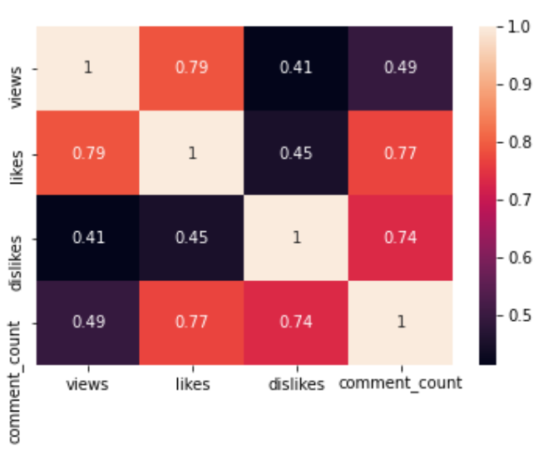
Correlation between different data elements
The heatmap here shows a correlation between the numerical values in our dataset like views, likes, dislikes and comment count.
The scale on the right indicates the range of correlation coefficient where 1 is perfect correlation and the lower the values, the less correlated the variables are.
Here, views and likes seem to have the highest correlation and dislikes and views seem to have the least correlation.

Slide 12
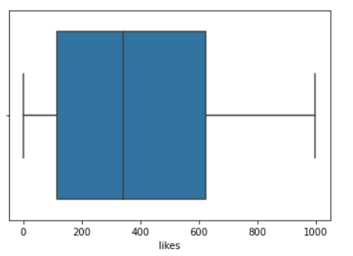
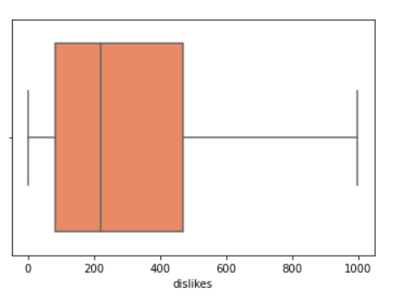
Preliminary visualizations
The below box plots represents the medians of the likes and dislikes in the dataset.
The interquartile range is much higher for likes than dislikes.
It shows that most videos in the trending page have higher like counts.

Slide 13
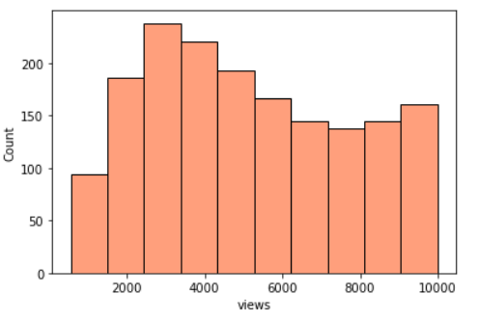
Preliminary visualizations
The below histogram represents the view count distribution among the different videos on the trending page of YouTube within out dataset.
We have only selected a subset of the data as the dataset contains a high number of entries.

Slide 14
Video category ID list:
1 – Film & Animation
2 – Autos & Vehicles
10 – Music
15 – Pets & Animals
17 – sports
19 – Travel & Events
20 – Gamin
22 – People & Blogs
23 – Comedy
24 – Entertainment
25 – News & Politics
26 – Howto & Style
27 – Education
28 – Science & Technology
29 – Nonprofits & Activism
30 – Movies
43 – Trailers
Source : https://gist.github.com/dgp/1b24bf2961521bd75d6c

Slide 15
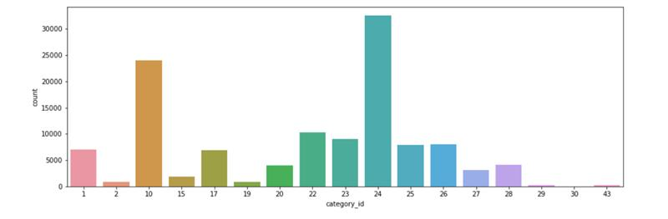
Preliminary visualizations
The histogram here shows the number of videos from each category present on the trending page
Here, the entertainment and music category seem to have the highest recurrence, the lowest are for movies and trailers.
1 – Film & Animation
2 – Autos & Vehicles
10 – Music
15 – Pets & Animals
17 – sports
19 – Travel & Events
20 – Gamin
22 – People & Blogs
23 – Comedy
24 – Entertainment
25 – News & Politics
26 – Howto & Style
27 – Education
28 – Science & Technology
29 – Nonprofits & Activism
30 – Movies
43 – Trailers

Slide 16
Additional data cleaning
We noted that while importing the dataset to Power BI, the video ID column contains symbols that were not recognizable to Power BI.
We ended up eliminating this column as we dint require it for any of our visualizations.

Slide 17
Data Transformation
We created some additional columns that allowed us to create cleaner visualizations, these include:
Categories (derived from category ID)
Upload Month
Upload day
Upload time
Trending day
Trending month.

Slide 18
Data Transformation
We noted that one the columns ‘trending date’ was in text format instead of date format.
We split the column using ‘split column’ using power query, into 3 separate columns of date, month and year.
We then merged the columns in the correct format using ‘-’ separator and then changed it into the date format.

Slide 19
Data Analysis
The visualization about to follow are all generated using PowerBI

Slide 20
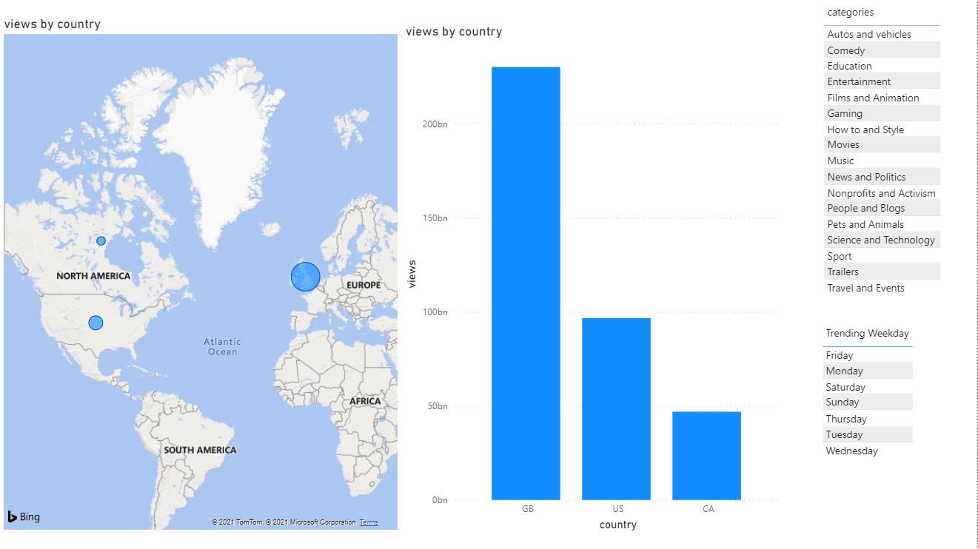
Views by Country

Slide 21
Views by Country
The visualization here shows the distribution of overall views between the United States, Canada and Great Britain.
We see here that most of the viewership on the trending page is from within Great Britain, followed by United States and Canada respectively.
In the Power BI file, we have added the option to filter these views based on the video categories and day of the week

Slide 22
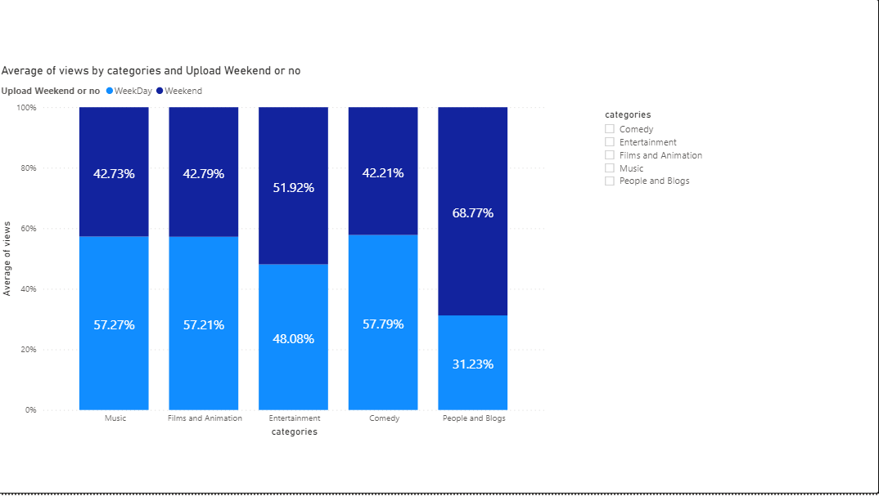
Weekday vs Weekend

Slide 23
Weekday vs Weekend
The 5 most popular category of videos on the trending page included – Music, Films & Animation, Entertainment, People & blogs and Comedy.
The chart shows a comparison between weekend vs weekday view count on the trending page.
We can see that for ‘music’, ‘films & animation’ and ‘comedy’ weekday uploads are favorable as viewership is greater on weekdays compared to weekends.
On the other hand, for ‘entertainment’ and ‘people & blogs’ the viewership seems to be greater on weekends.

Slide 24
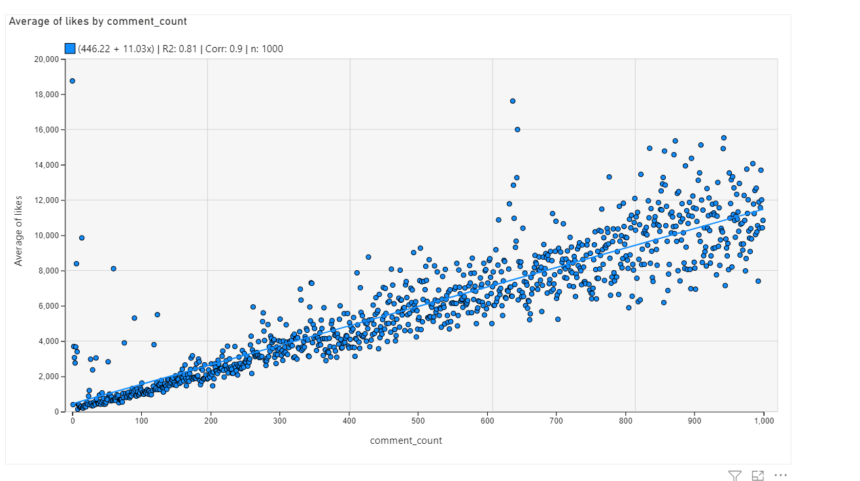
Correlation between likes and comments

Slide 25
Likes and comments correlation
The visualization here depicts the correlation between comment and likes on videos.
The YouTube algorithm takes comments on a video as engagement, which in turn increases its chances of ending up on the trending page.
Since like count is directly proportional to the ability to monetize a video, it is always favorable to maximize likes received for a content creator.
Both likes and comments seem to be strongly correlated.

Slide 26
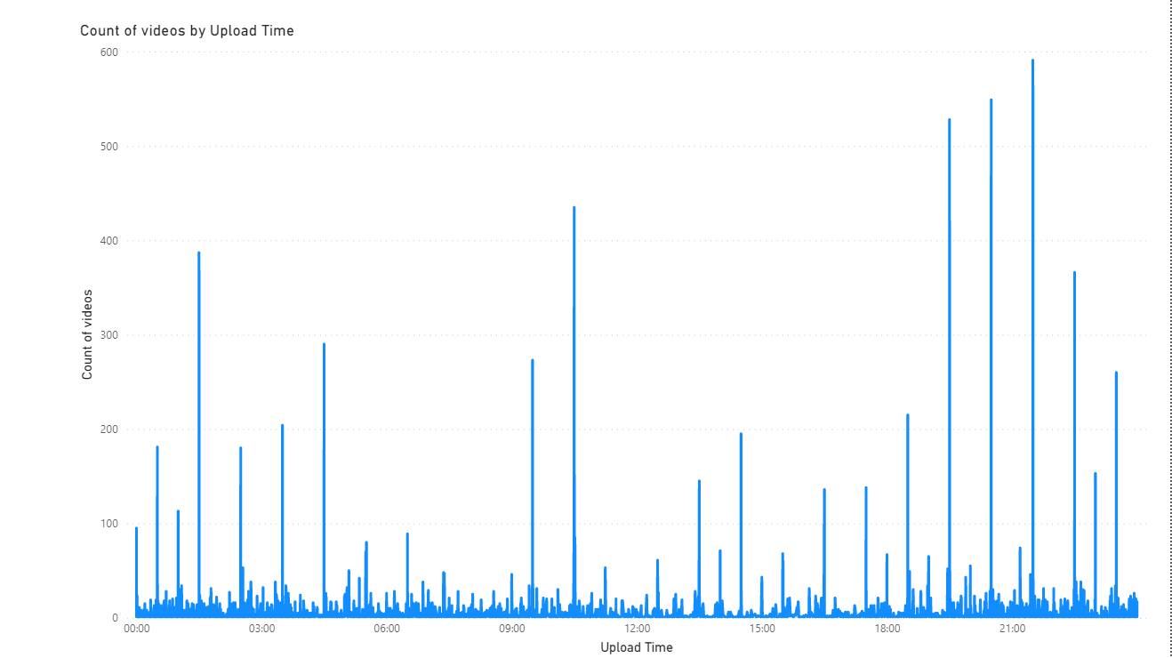
Significance of upload time

Slide 27
Significance of upload time
The frequency graph here shows videos on the trending page, uploaded in 2017 / 2018 and their respective time of upload.
It clearly shows uploads during the evening hours between 7 pm and 9:30 pm have the greatest number of videos ending up on the trending page.
1:30 am and 10:30 am also seem to have a good number of videos showing up on the trending page.
It allows us to also identify that the worst time for a video upload is between 5:30 am and 9 am.

Slide 28
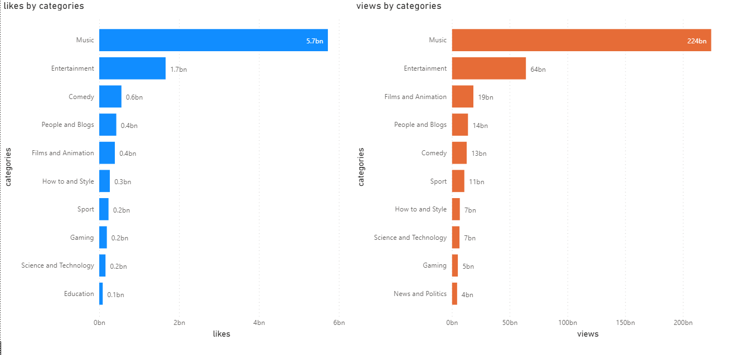
Views and likes by category

Slide 29
Views and likes by category
The blue graph represents likes received for each category on the trending page and the red graph on the right represent the number of views for the same.
Only the top 10 categories on the platform have been represented in the visualization.
Music is by far the most watched and liked category on the trending page, followed by entertainment.
We can also identify that the ratio between views and likes are not always directly proportional.

Slide 30
Views to likes ratio for the top 5 categories
Music - 39.2 : 1
Entertainment - 37.4 : 1
Comedy - 21.6 : 1
Films - 47.5 : 1
People and blogs - 35 : 1
Here we can see that comedy has the best ratio between views and likes. (This can be understood as 1 like generated for 39.2 viewers on average, in the Music genre)
This allows us to infer that a viewer is more likely to click like on a video in the comedy genre far more than something from the Films genre.
Since likes play a major factor in terms of video popularity as well monetary generation, having a lower ratio is preferable.

Slide 31
Conclusion
Engagement
Likes, views and comments play a significant role in deciding if a video ends up on the trending page of YouTube. The YouTube algorithm calculates engagement by viewers through a combination of these factors.
It was also noted dislikes did not seem to significantly impact a videos popularity on the trending page.
Upload Day
We noted that when you upload a video matters based on day of week as well as category of video uploaded.
Weekends tend to receive higher viewership for the ‘entertainment’ and ‘people & blogs’ categories, whereas ‘music’, ‘films & animation’ and ‘comedy’ tend to do better on weekdays.

Slide 32
Conclusion
Upload Time
Upload time tends to significantly impact the chance of a video ending up on the trending page.
We noted the best time to upload a video was in the evening between 7 pm and 9:30 pm while the worst time to do so is between 5:30 am and 9 am.
Category Selection
The categories that are most likely to end up on the trending page are from music and entertainment, since it makes up a major portion of YouTube's trending page.
Likes happen to be major component when it comes to monetization of a video. It was noted that certain categories had a better chance of getting liked by a viewer.
The ‘comedy’ genre showed to have the best ratio between views to likes at 21.6 : 1 followed by ‘people and blogs’ at 35 : 1. getting

